Slide 1
C The Programming Language
Input /Output (I/O): Console I/O, formatted and unformatted console I/O functions

Slide 2
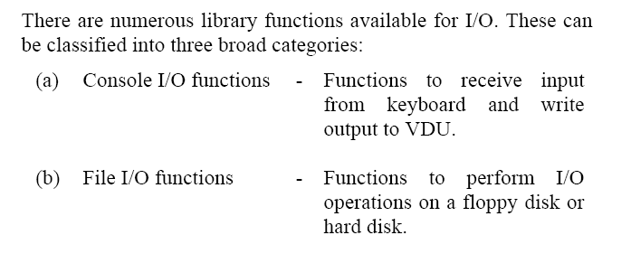
Introduction:

Slide 3
Console I/O Functions
The screen and keyboard together are called a console.
Console I/O functions can be further classified into two categories:
formatted
unformatted console I/O functions.
Formatted functions allow the input read from the keyboard or the output displayed on the VDU to be formatted as per our requirements.

Slide 4
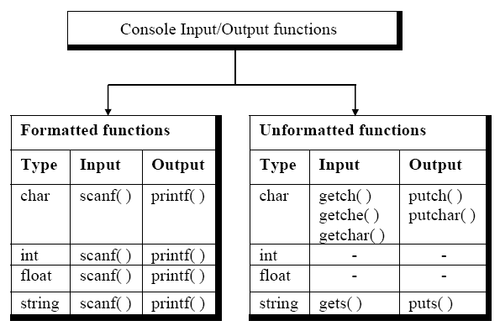

Slide 5
File Input/output
Why FILE I/O?
Displaying data on screen is not enough.
Limited amount of data can be
Displayed on screen
Stored in memory(Memory Issues)
Volatile, data is lost when program terminates.
What if we need that data again?
Solution:
Use file store on disk
Perform I/O manipulation on file.

Slide 6
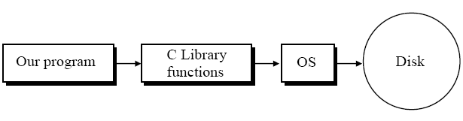
Data organization:
data stored on the disk is in binary form.
varies from one OS to another.
this does not affect the C programmer.
uses the library functions written for the particular OS.
It is the compiler vendor’s responsibility.

Slide 7
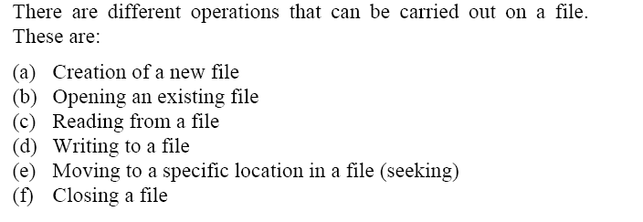
File Operations:

Slide 8
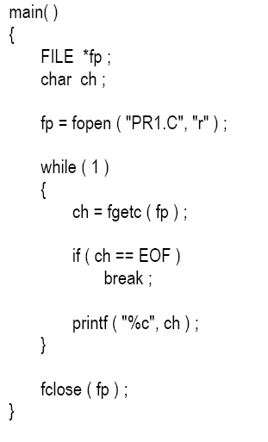
Simple File Read Program:

Slide 9
Opening a File
Before any read (or write) operation:
Need to open a file.
To open the file we have called the function fopen( ).
Use fopen(“File Name”,”mode:read/write”)
Searches the file to be opened on disk.
Loads the file in memory (buffer).
Sets up character pointer.
Pointing to first character of the buffer.
Why we need buffer to read or write?
Accessing secondary storage device is slow e.g hard drive, floppy drive flash etc.

Slide 10
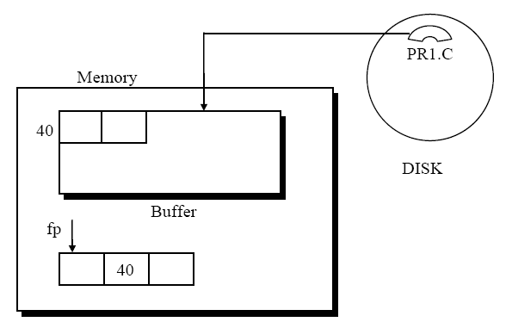

Slide 11
Reading/Writing From a File:
To be able to successfully read/write from a file:
Need to have certain information:
mode of opening, (read or write)
size of file,
place in the file from where the next read operation would be performed, etc .
fopen() gathers all.
In a structure FILE. fopen( )
Returns the address of “File” Structure
Stored in a pointer of type “File”. FILE *fp ;
The FILE structure has been defined in the header file “stdio.h”
Must be used #include <stdio.h>

Slide 12
Reading/ Writing from a File
Once the file has been opened
File is stored in a buffer.
Pointer points to the first character in buffer
Reading file from buffer
Use fgetc() function
Reads a character and advances to the next location
EOF
A special character ASCII 26
Inserted after last character in the file.

Slide 13
Trouble Opening A file:
When we try to open a file using fopen
Read mode
Opening a file that does not exist
Write mode
Insufficient disk space
Disk may be write protected
Disk is damaged and so on
Therefore, make sure that file is open before any read/write operation
But how?
If file opening fails due to any reasons.
NULL is returned by fopen().

Slide 14
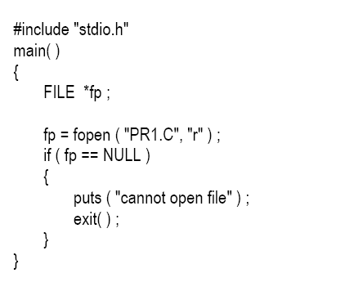
Ensuring File Opening

Slide 15
Closing a File:
Reading from a file
Use fclose(fp)
Once file is closed its no longer accessible
Buffer associated with the file is removed from memory.
Suppose we open a file with an intention to write characters into it. This time too a buffer would get associated with it.
When fclose( fp) is used:
The characters in the buffer would be written to the file on the disk.
At the end of file a character with ASCII value 26 would get written.
The buffer would be eliminated from memory.

Slide 16
A File-copy Program :
We have already used the function fgetc( ) which reads characters from a file.
Its counterpart is a function called fputc( ) which writes characters to a file.
As a practical use of these character I/O functions we can copy the contents of one file into another

Slide 17
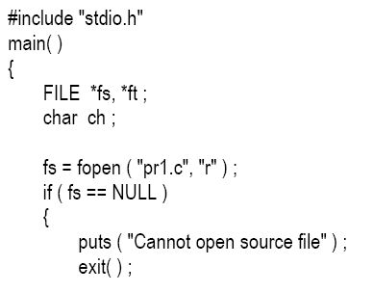
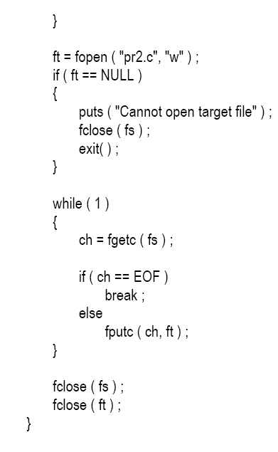

Slide 18
Writing to a File:
The fputc( ) function is similar to the putch( ) function, in the sense that both output characters.
putch( ) function always writes to the VDU.
fputc( ) writes to the file,file signified by ft.

Slide 19
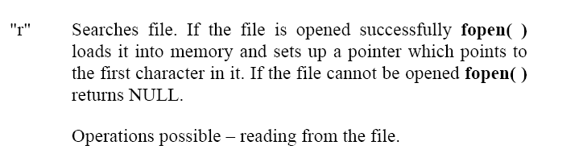
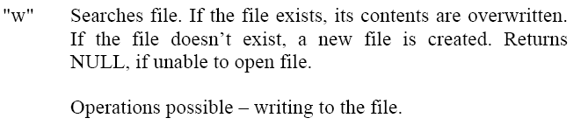
File Opening Modes:

Slide 20
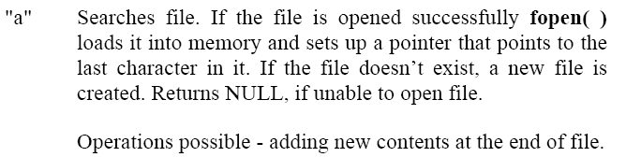
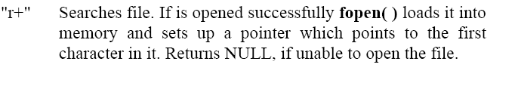


Slide 21
